Slide 1
P&L IOT Project
12/07/2018
Raffaele Sommese, Antonio Varvara, Federico Ucchesu

Slide 2
Overview
Fire Detection board based on FEZ Spider II equipped with:
Flame Detector, Smoke Detector (MQ2) , Co Detector (MQ7) , Buzzer and Temperature Sensor (LM35).
Temperature and Humidity Monitor Board based on Esp8266 equipped with: DHT11 Sensor.
Aws IoT Button :)

Slide 3
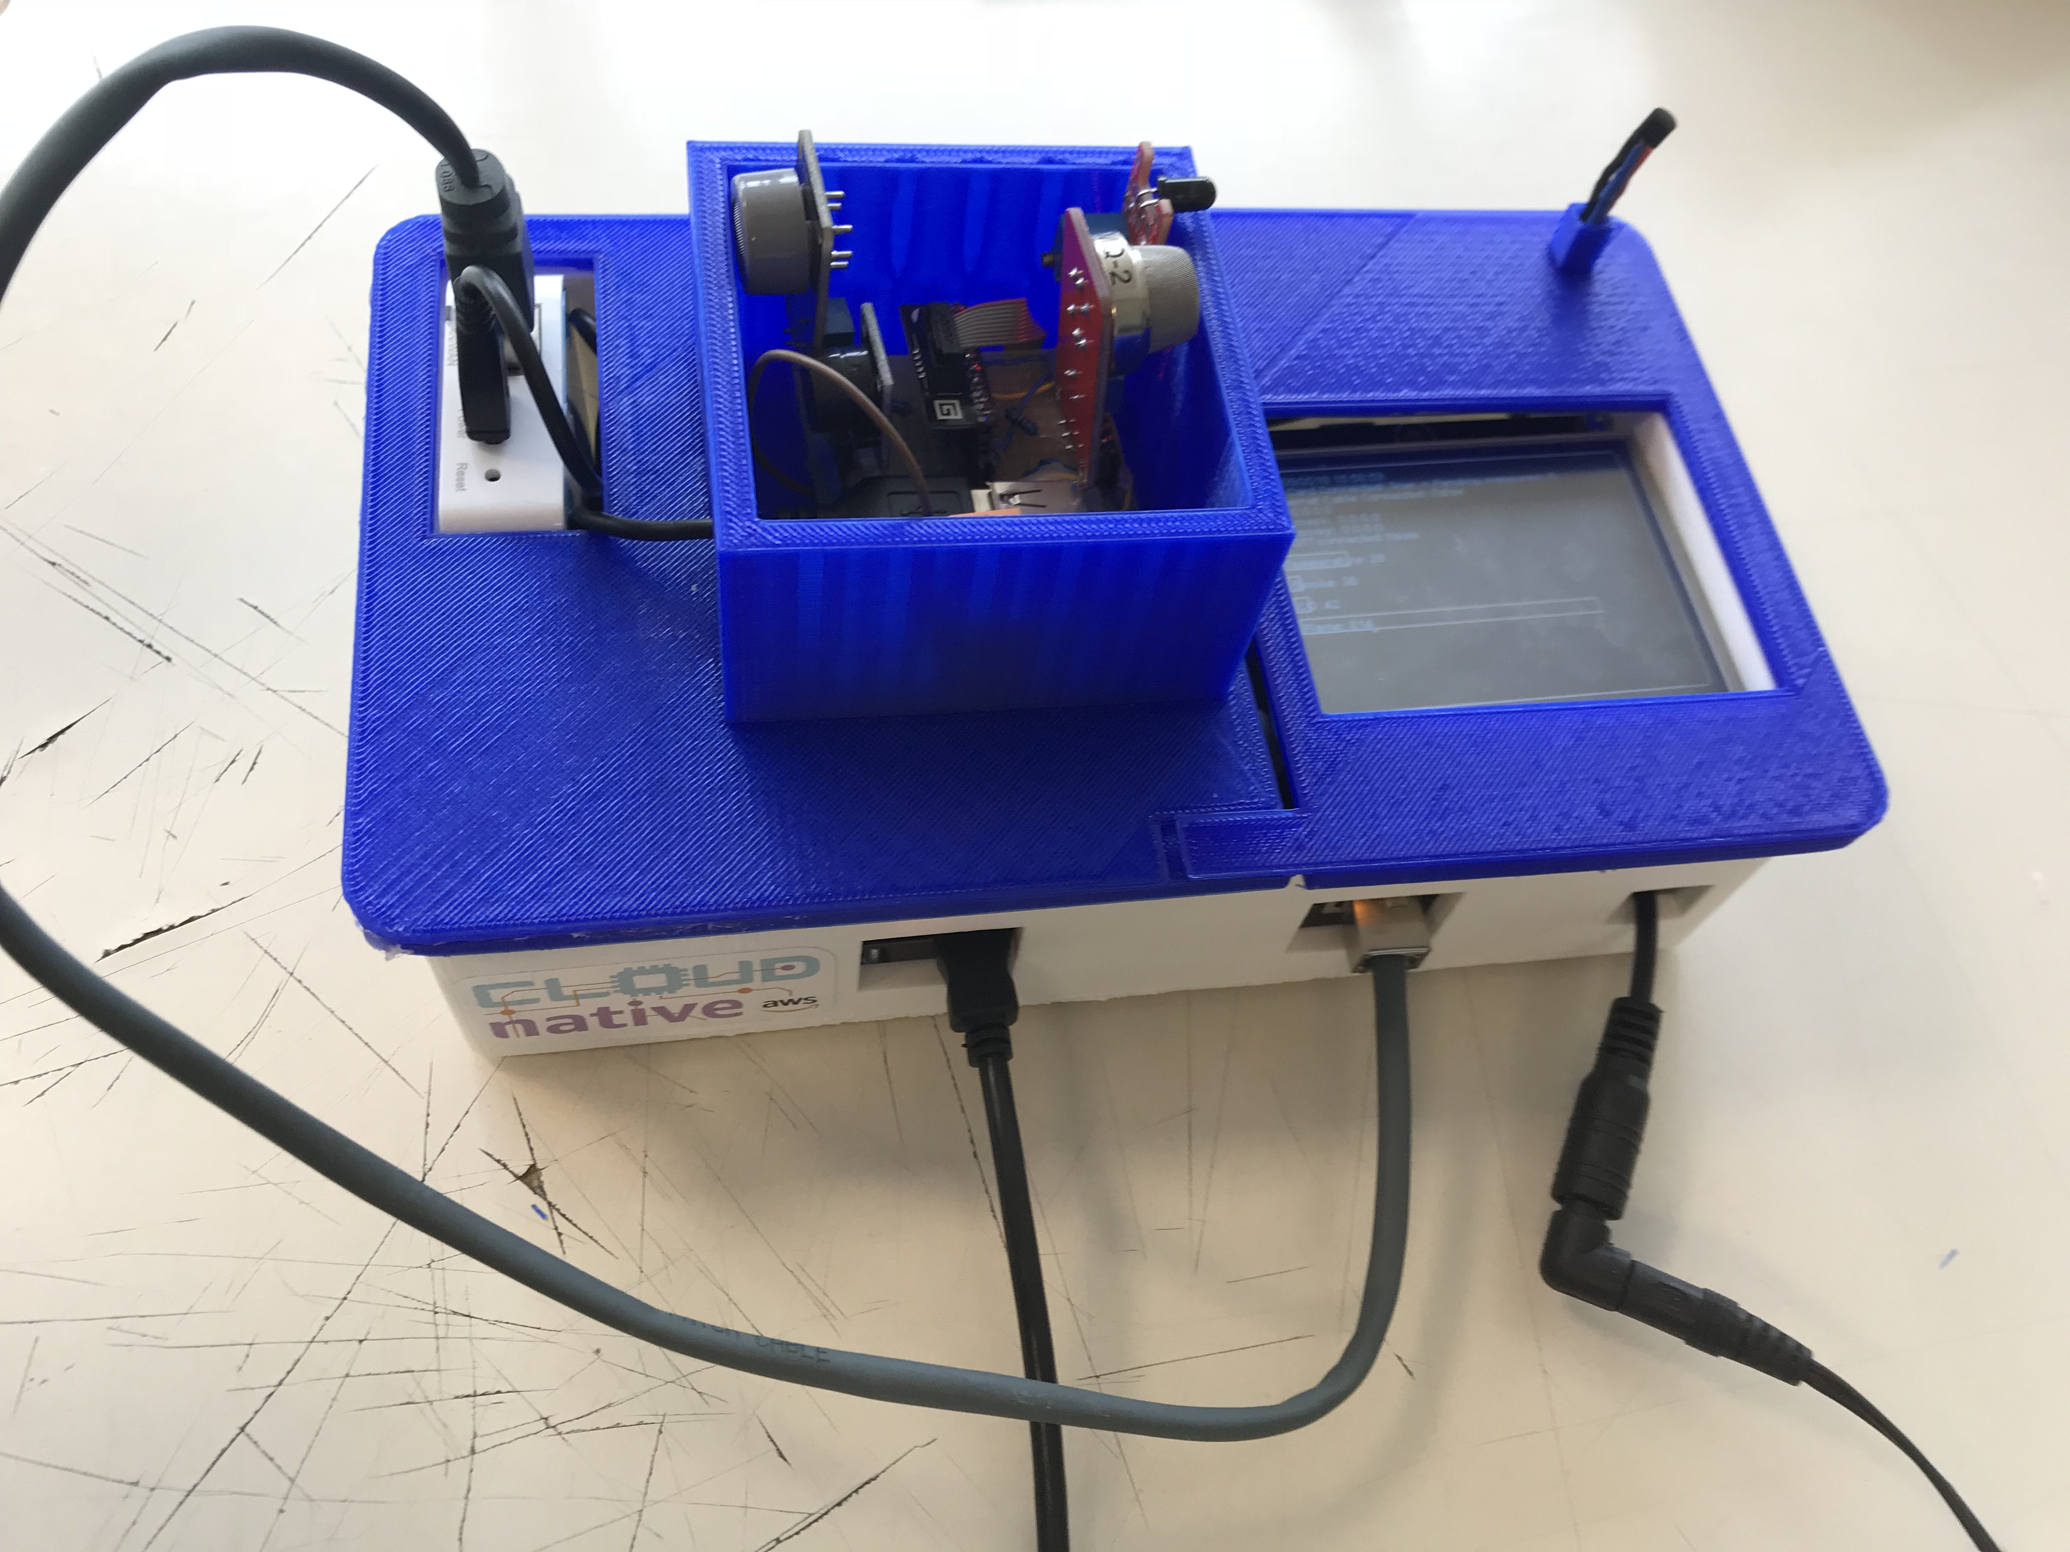
FIre Sensor Board

Slide 4

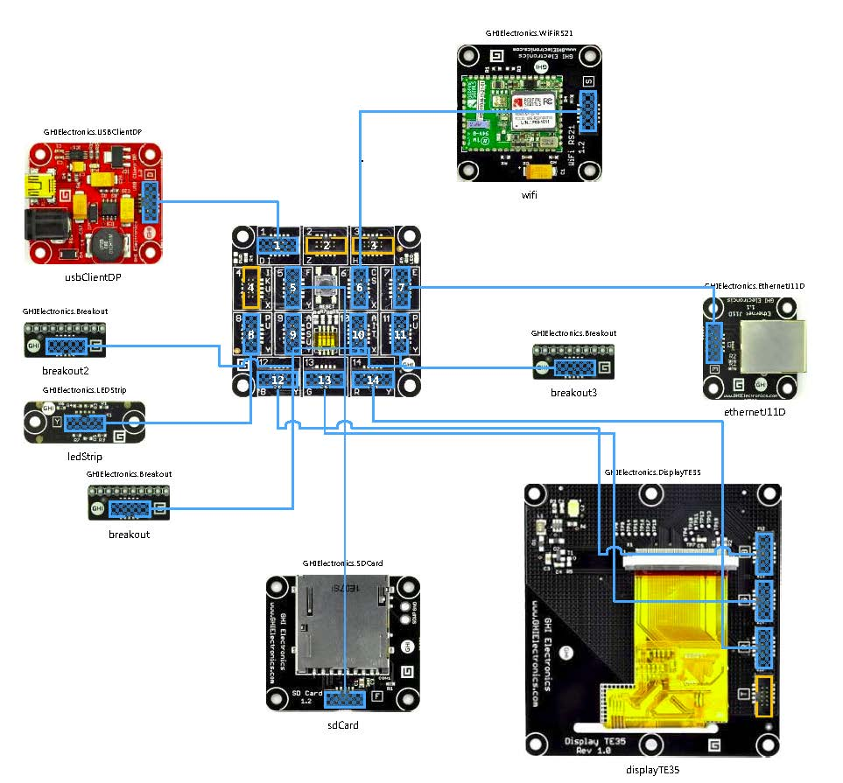
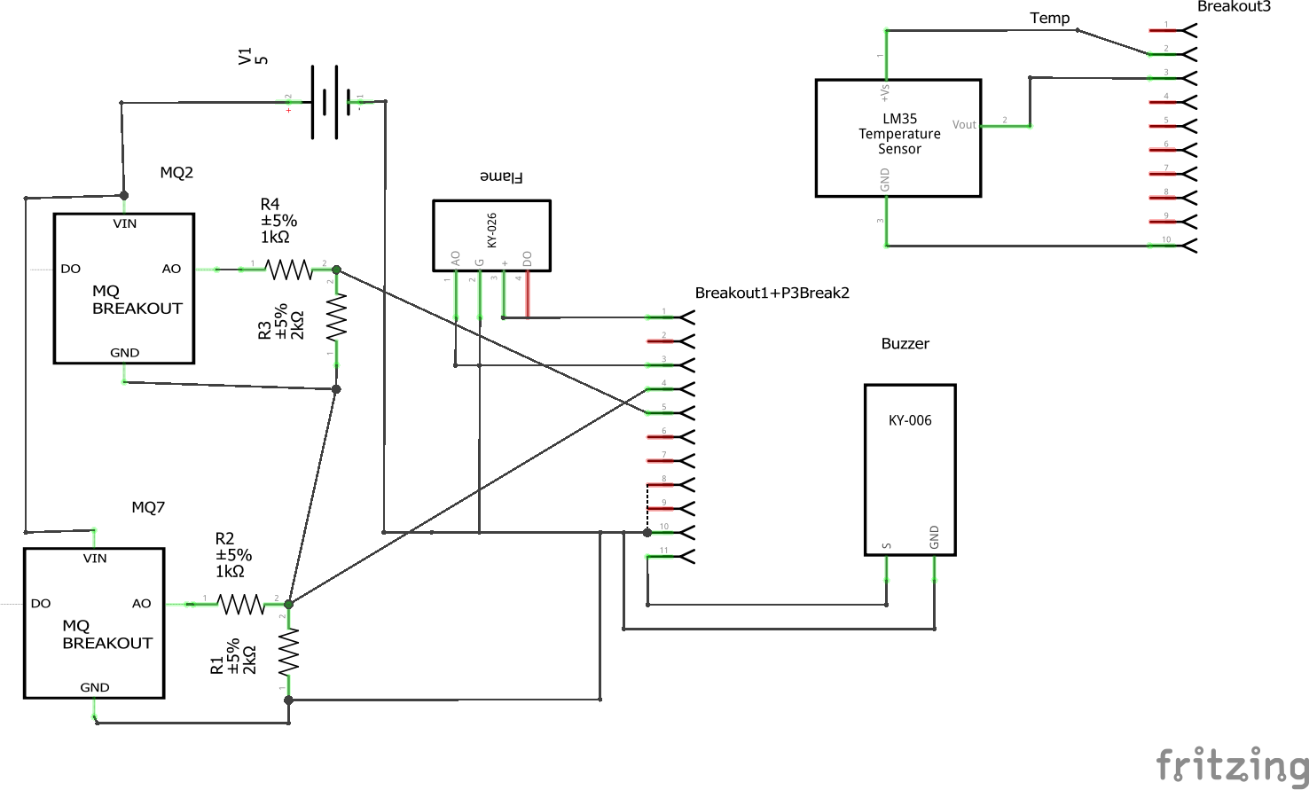
Fez Electronic Schema

Slide 5
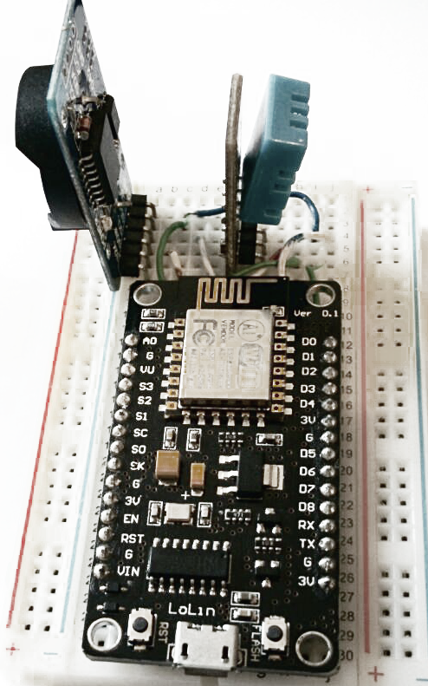
Temperature and Humidity Board

Slide 6

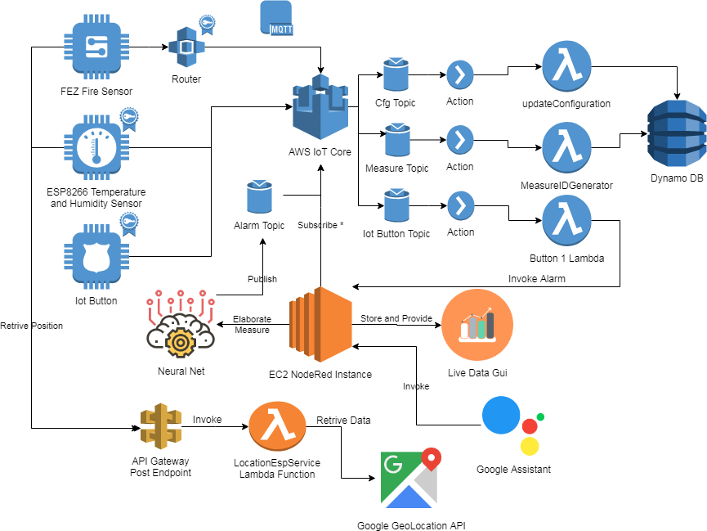
Cloud Architecture

Slide 7
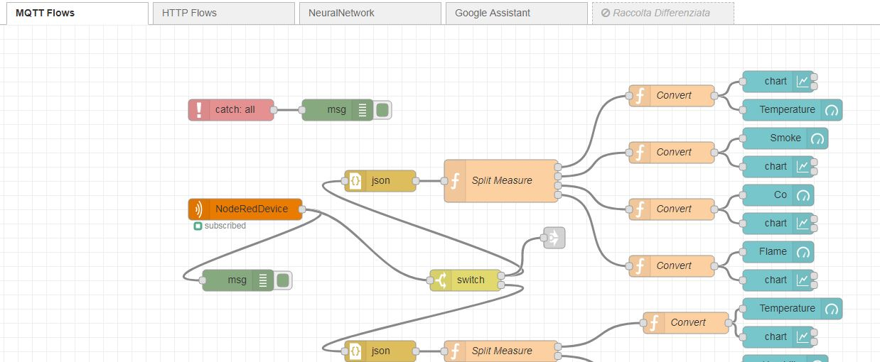
Node Red

Slide 8
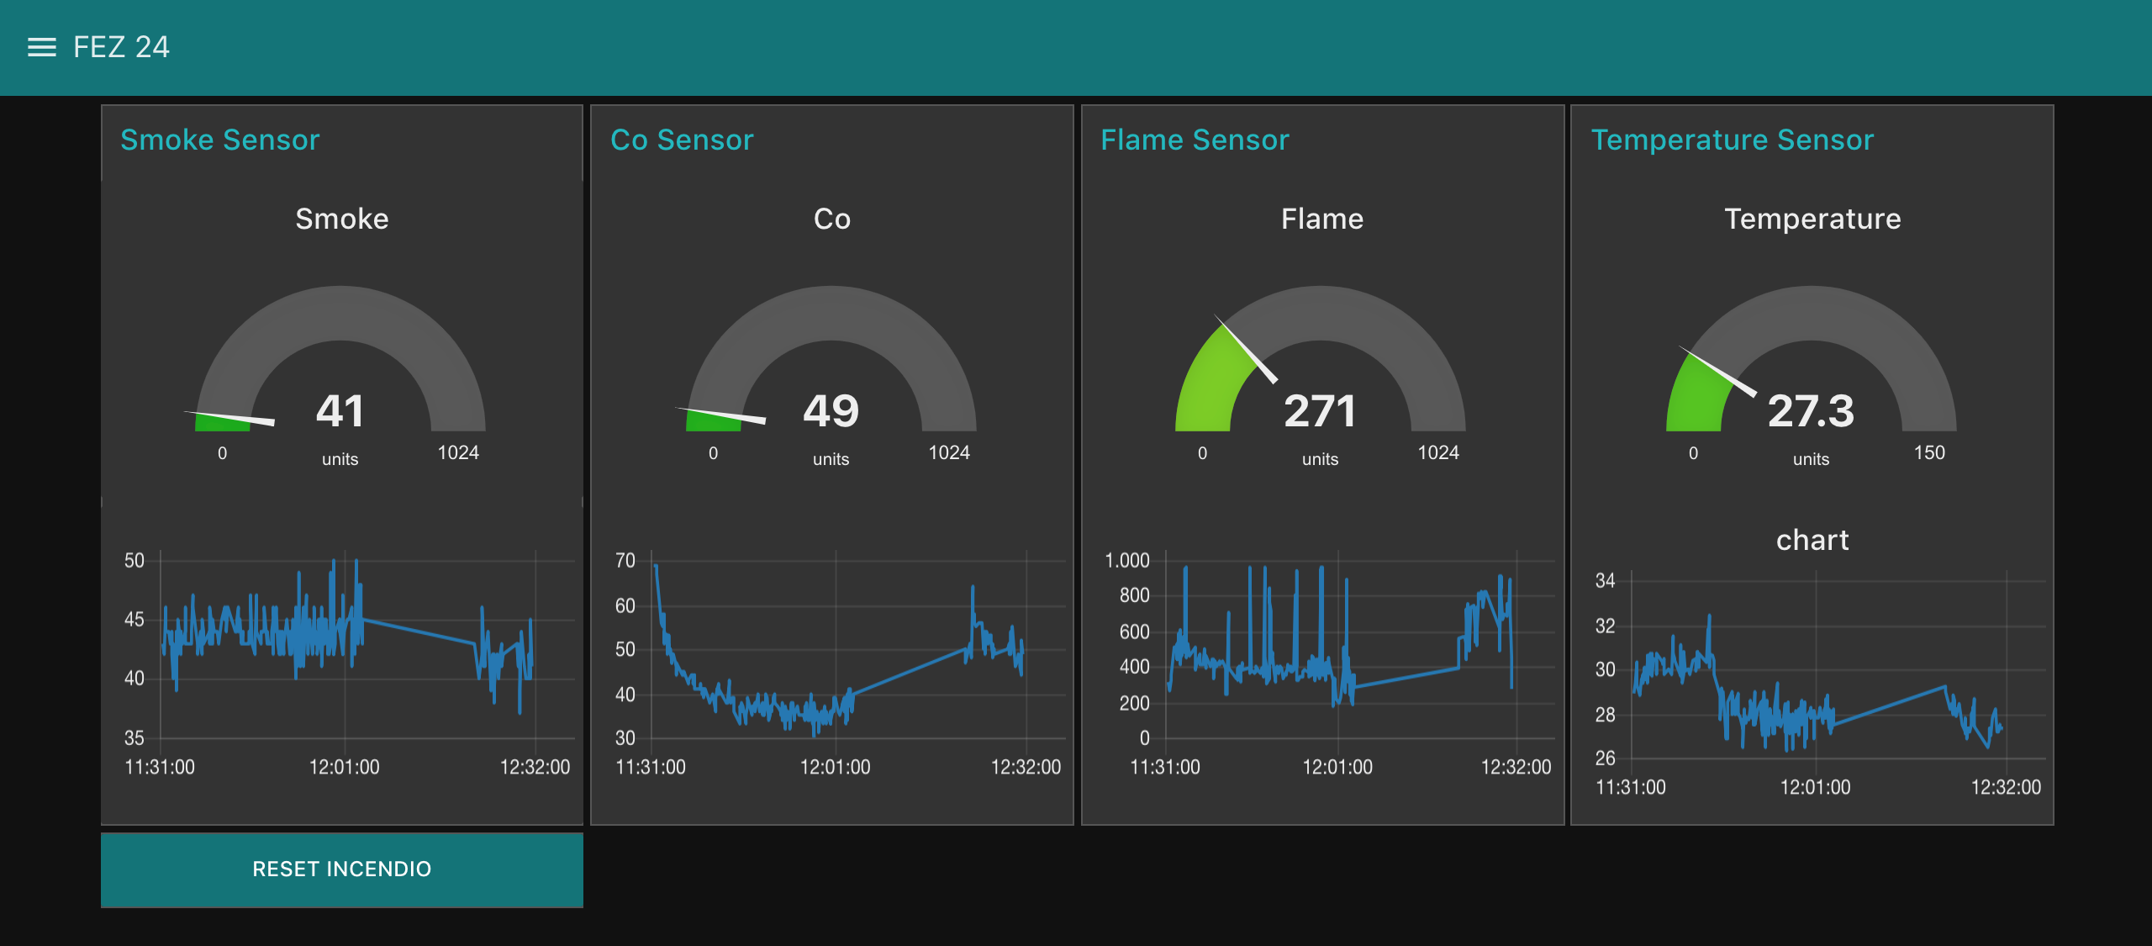
Live DAta UI

Slide 9
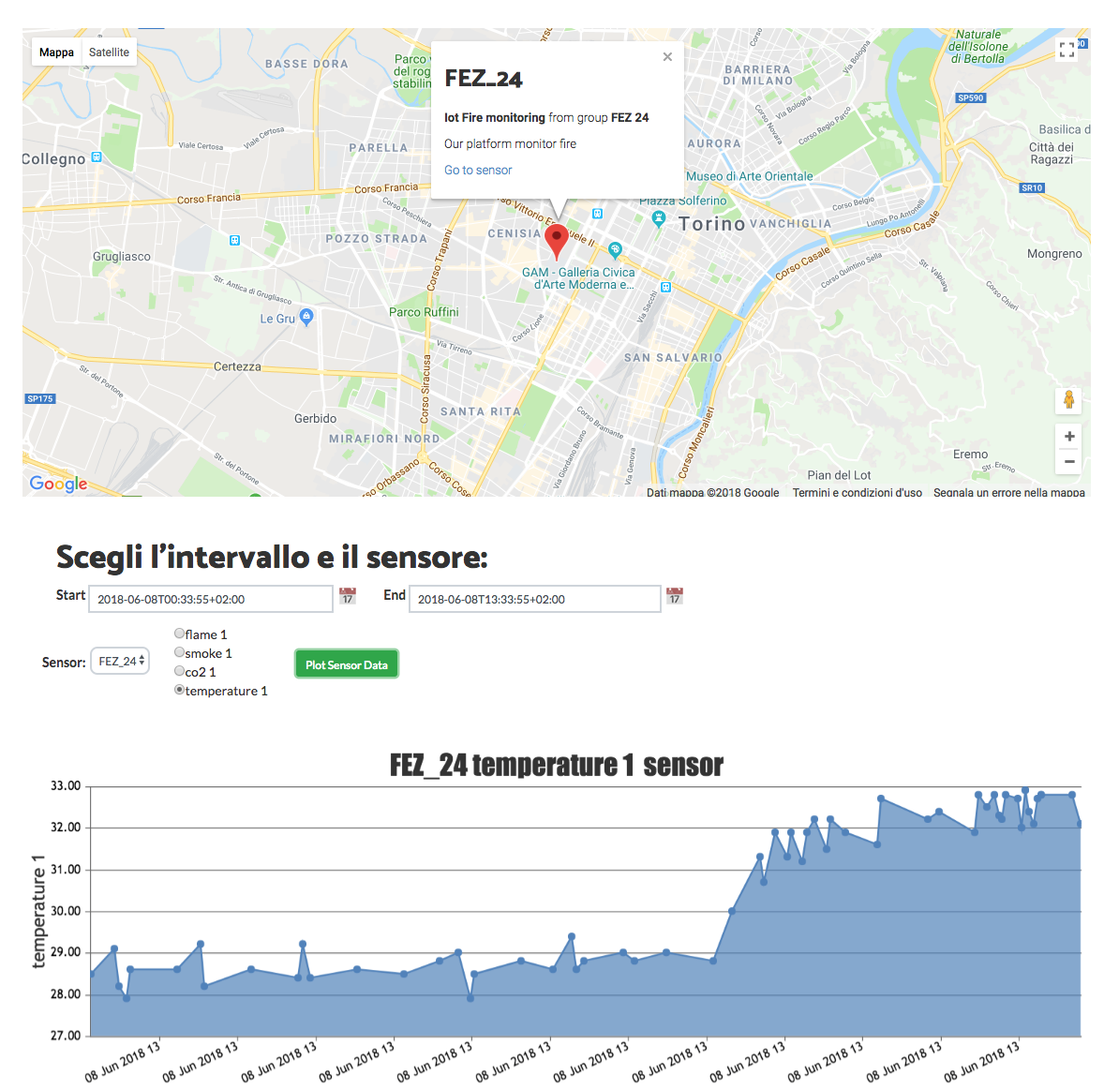

Historical Data UI

Slide 10
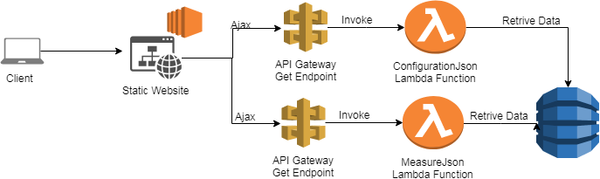
Historical Data Ui: Under The Hood

Slide 11
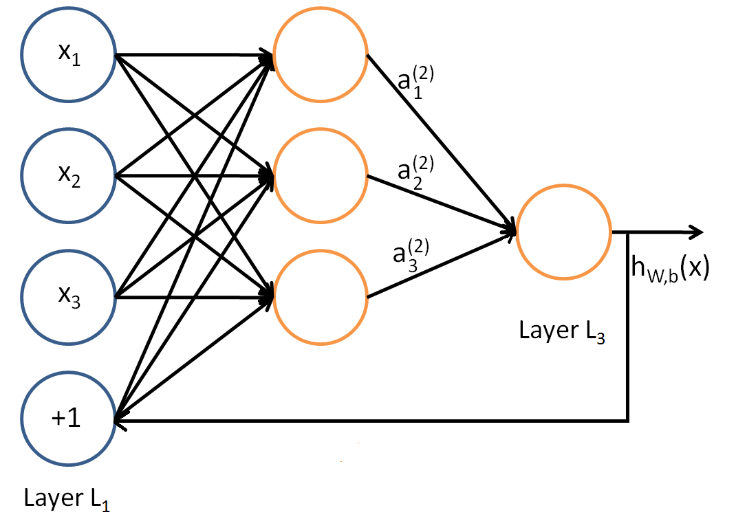
Feedforward neural Network
Input:
The values read from the sensors, plus the last value returned in output in the last iteration
Output:
The probability that there is a fire

Slide 12
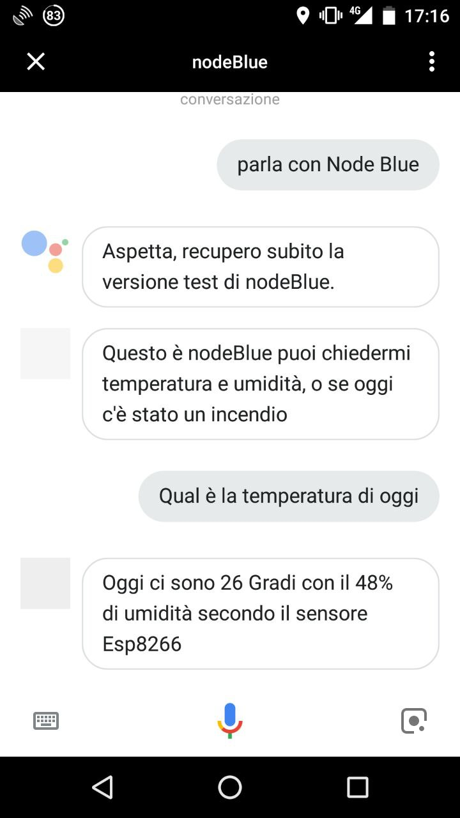
Google Assistant
Integrated with Google Assistant, the application provides data about:
Temperature and humidity
Fire board Sensor
Fire Detection
And allow the user to activate the fire alarm

